Slide 1
Digital Marketing Offerings

Slide 2
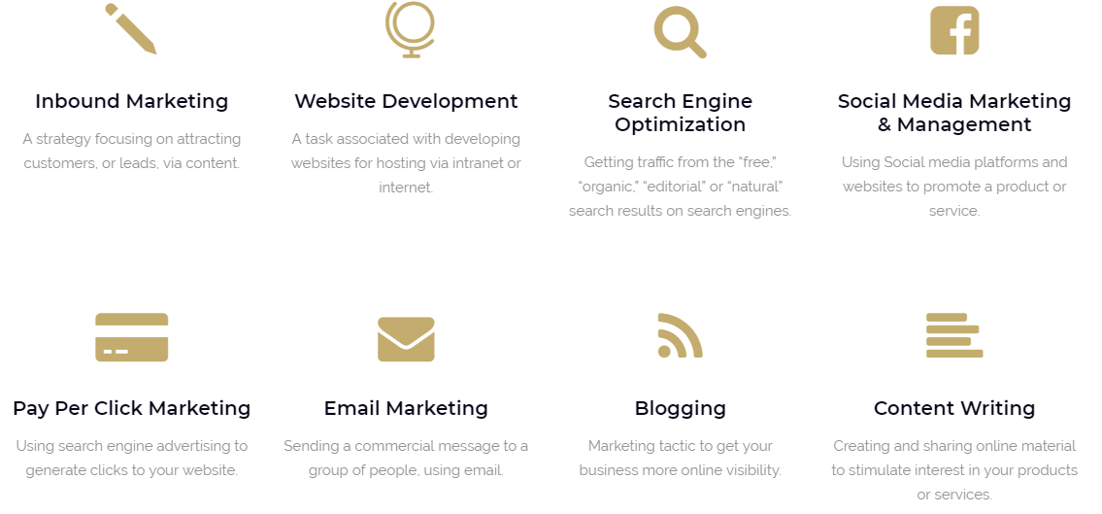
Our Services
Appriffy - Digital IT Hub Presentation

Slide 3
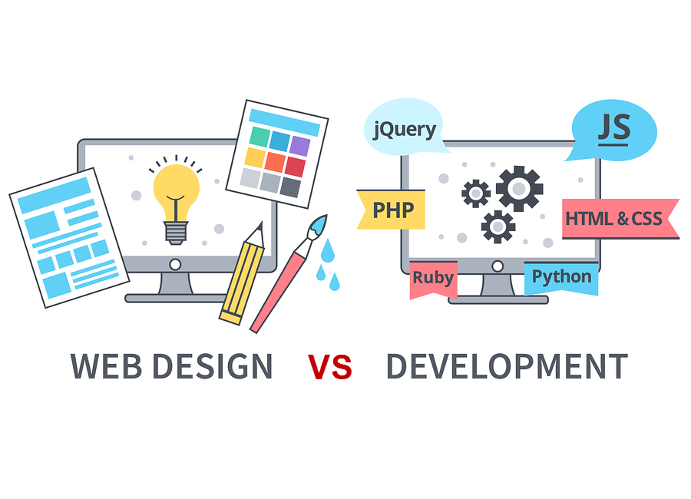
Web Design & Development
Your website is the centre of your digital presence. It's one of the few places on the internet where you can deliver your brand's message free of distortion or distraction.
We can help you build your brand's website from the ground up. We specialize in building websites that tell a unique brand story while meeting the expectations of today's most discerning consumers.
If your website is already built but isn't performing to expectations, we can perform a detailed audit and work with you to improve site architecture, design, and responsiveness.
Appriffy - Digital IT Hub Presentation

Slide 4
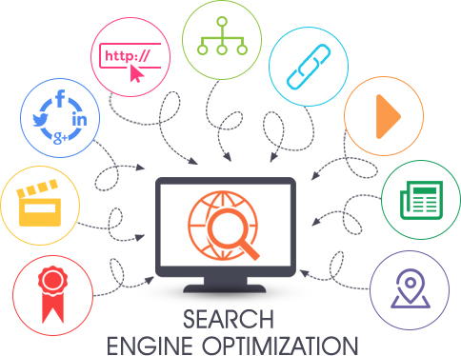
Search Engine Optimization
Billions of web browsing sessions begin with a search query every day. With more than a billion websites competing for the top spot in search results, it can be difficult to drive traffic to your site from search engines.
At Appriffy -Digital IT Hub, we specialize in an innovative approach to SEO that uses white-hat tactics to put your website at the top of your target audience's searches.
Our SEO services include:
Keyword Research
Technical SEO
Full SEO Audits
SEO Consulting
Appriffy - Digital IT Hub Presentation

Slide 5
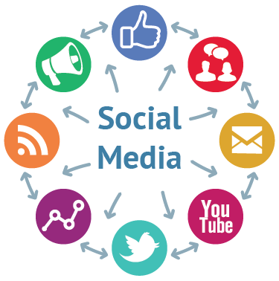
Social Media Marketing
Our full suite of social media services includes:
Social Strategy Development
Social Media Consulting
Social Media Advertising
Community Engagement
Facebook Marketing
Twitter Marketing
Instagram Marketing
Quora Marketing
Youtube Marketing
Appriffy - Digital IT Hub Presentation

Slide 6
Paid Marketing Campaigns
More than 60% of website traffic starts with a search engine query. Pay-Per-Click (PPC) & Facebook Ads puts your brand at the top of search results for queries relevant to your brand and audience. This valuable advertising real estate can provide an immediate source of targeted traffic to your website, driving conversions and contributing to revenue growth.
At Appriffy -Digital IT Hub, we have extensive experience leveraging Paid marketing to drive growth for our clients. Our approach to Paid marketing is data driven, which allows us to deploy campaigns that focus on efficiency and constant improvement.
Our Paid services include:
Facebook Ad Marketing
Google Adwords
Appriffy - Digital IT Hub Presentation

Slide 7
Paid Marketing Managed Platforms
Designed by New Haircut
Appriffy - Digital IT Hub Presentation
page

Slide 8
Content Marketing & Blogging
Our full suite of content services includes:
Digital Content Strategy
Graphic Design
Blogging
Engaging Social Media Posts
Appriffy - Digital IT Hub Presentation

Slide 9
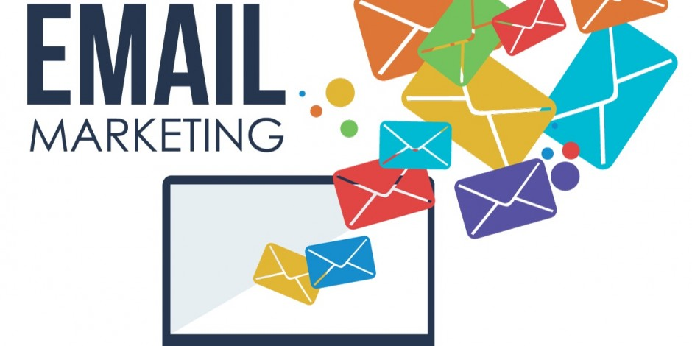
Email Marketing
Everybody is doing it. Email marketing drives sales.
We help Create, Send and Track Professional Email Campaigns & Automate Emails. Our Email services include:
Import, Build and Manage Your Contact List
Design HTML Email Campaigns
Send Emails
Track and Analyze Email Marketing
Appriffy - Digital IT Hub Presentation

Slide 10
Contact Info
https://www.facebook.com/Appriffy/
Appriffy
Digital IT Hub Pvt.Ltd
https://www.linkedin.com/company/appriffy/
rehan.sheikh@appriffy.com
91-9004686253 / 91-9148769507
Thank You
Appriffy - Digital IT Hub Presentation

